Slide 1
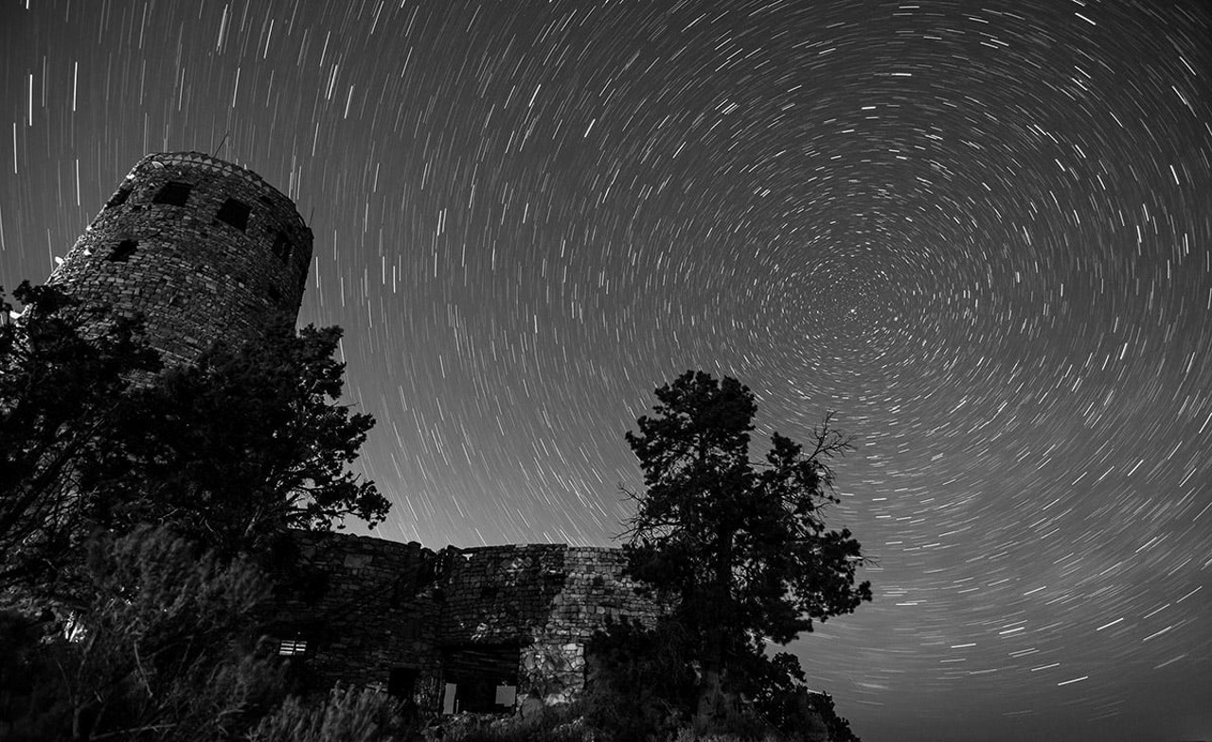





Team 3 Project 1
UFOs
Sam Fountain | Cara Boldarini | Irina Tenis | Yanqiu Yang | Sushil Murali

Slide 2
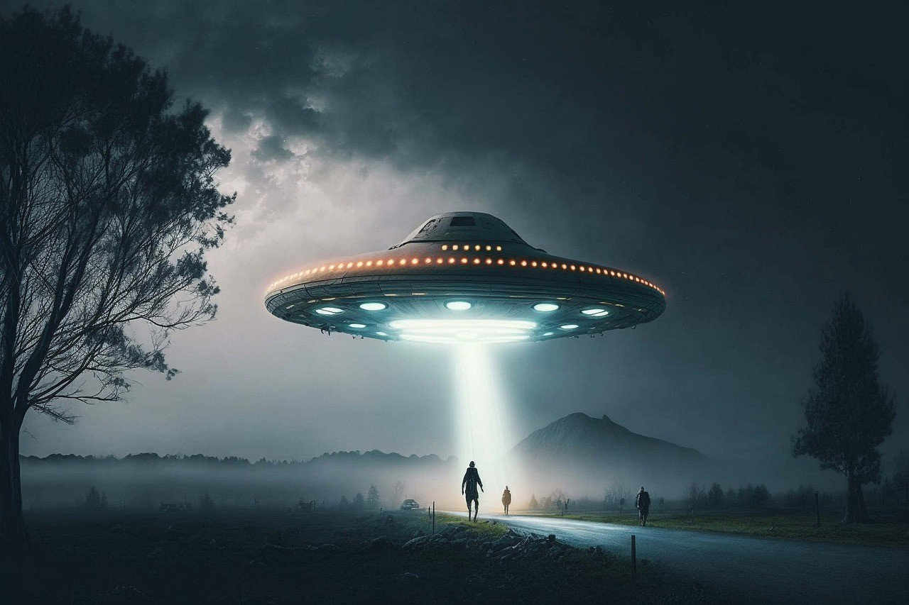
Project Introduction
The truth is out there!!?
For centuries, humans have reported seeing mysterious lights in the sky, but evidence of extraterrestrial life has eluded mankind.
Following sightings in the early 20th century, a database has been compiled of unexplained lights and shapes in the sky which could be proof of stellar visitors.
Using this data, our group explores a number of different aspects of the apparitions
Using data from NUFORC.org
Image credit: KarstenBergmann
Pixabay

Slide 3
Questions
While we have a million unanswered questions about aliens and UFOs,
let’s tackle a few popular ones first…
Based on historical data, what is the most likely geographical location for an alien ship sighting?
What are the most common colors or shapes have UFOs been spotted so far?
How frequently have UFOs been spotted based on time of the day, month of the year?
Where are UFOs most commonly sighted?
Has earth’s climatic changes and weather patterns impacted these UFO sightings in the past?
Using data from NUFORC.org
Image credit: KarstenBergmann
Pixabay

Slide 4
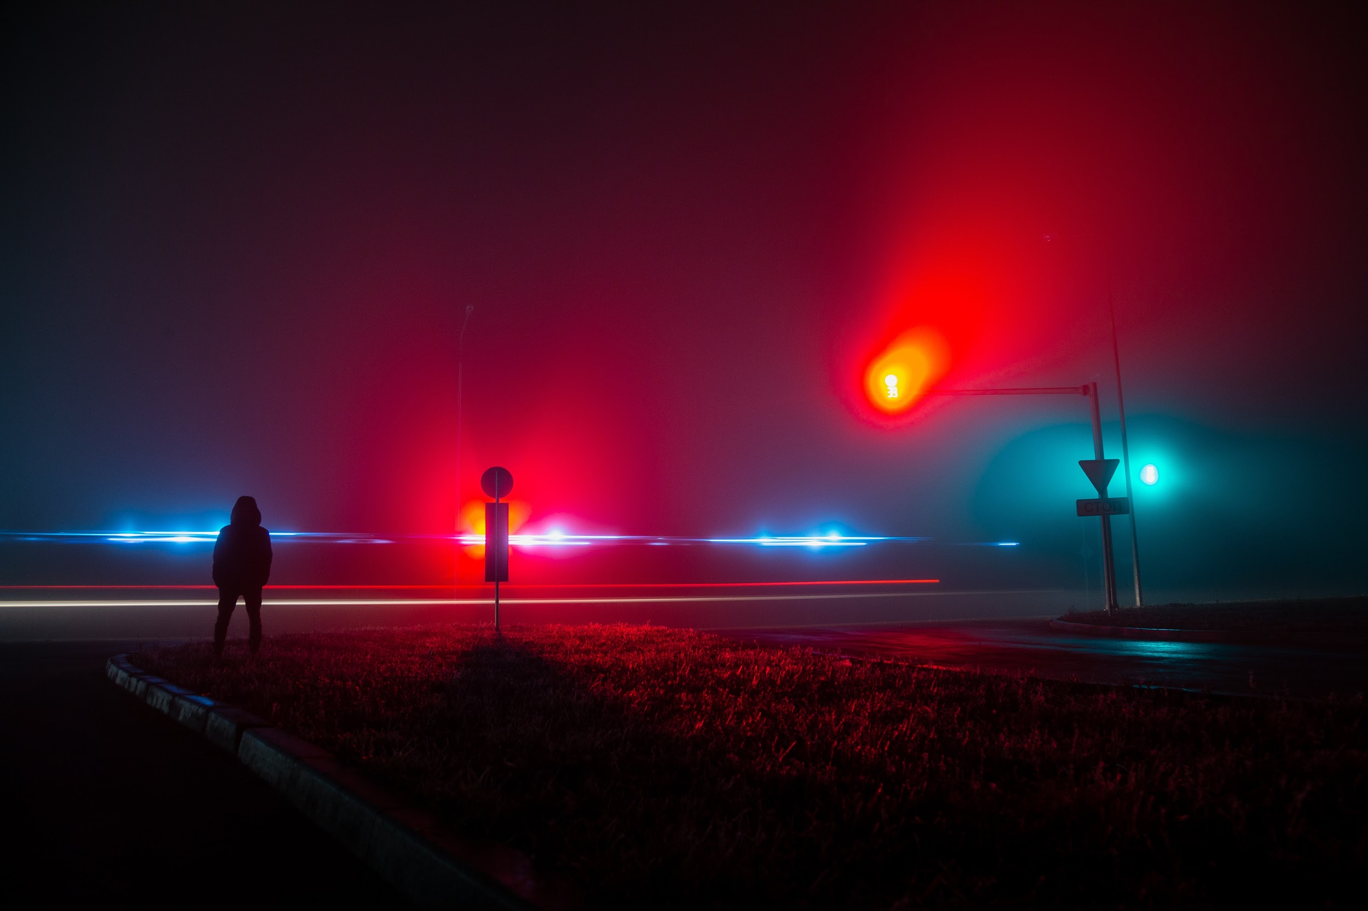
Tasks
Sam Fountain - Investigates the duration and locations of UFO sightings.
Yanqiu Yang - Explores how weather affects reported UFO sightings.
Cara Boldarini - Looks at the dates and time patterns of UFO sightings.
Irina Tenis - Examines the most common UFO shapes and colors recorded so far.
Sushil Murali - Calculates correlations between the UFO data and Global Nuclear Explosion data.
Using data from NUFORC.org

Slide 5

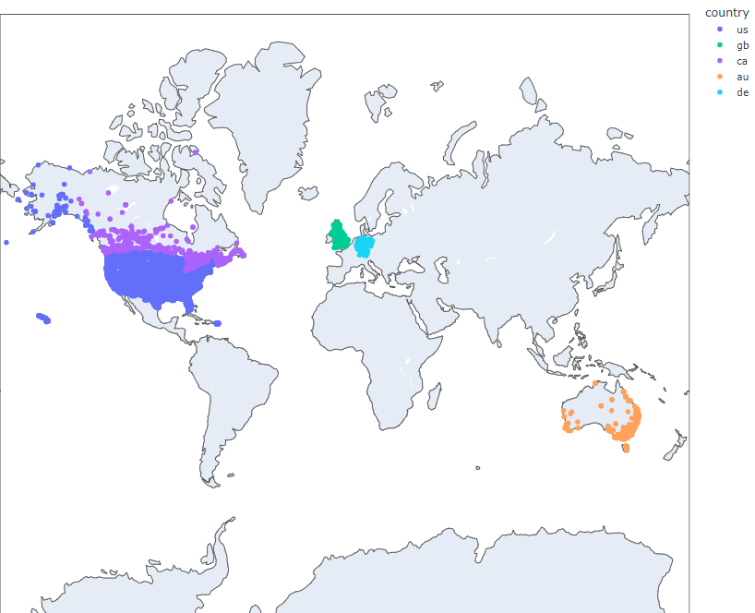
Locations
Visualization using a choropleth map
Plotting 80,000+ data points turned out to be prohibitive, so this visualization focuses on sightings data for the USA.
California - 9655
Washington - 4268
Florida - 4200
Texas - 3677
New york - 3219
As the UFO data contains more than eighty thousand sighting locations, mapping them out on a global scale offers little definition but more importantly, crashes Jupyter Lab!
Photo by Aksonsat Uanthoeng: https://www.pexels.com/photo/close-up-photo-of-assorted-color-of-push-pins-on-map-1078850/
Using data from NUFORC.org
Notes:
I performed a count on just the state data, modified the abbreviation to be recognized by plotly and fed that data into a choropleth map

Slide 6
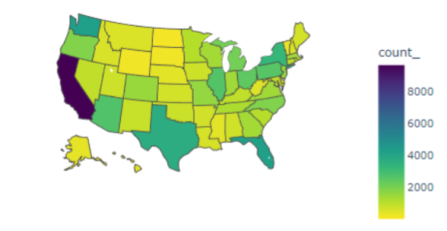
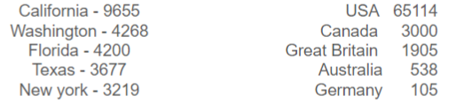
Visualization using a choropleth map
After sorting and cleaning the data, approximately 70,000 sightings remained, with over 93% occurring in the US.
Mapping the US data gives some insight into the distribution of sightings, with California taking the lion’s share of the events. Surprised?
Using data from NUFORC.org

Slide 7
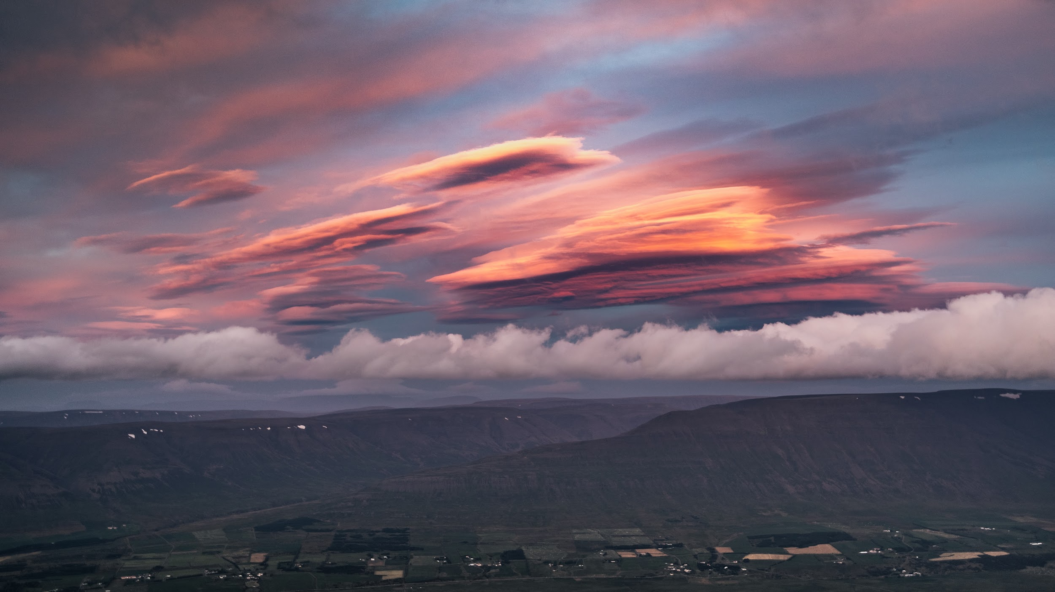
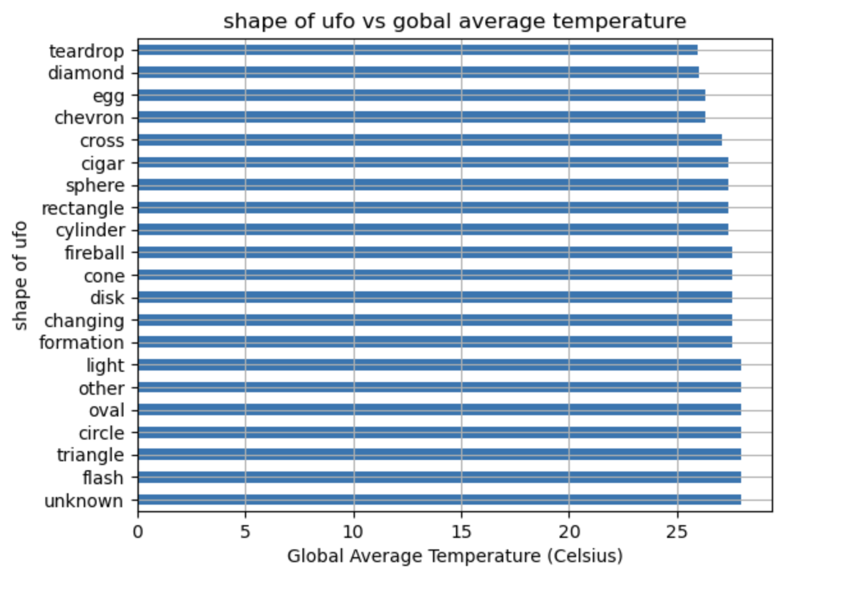
Weather
Reflection:
1.Getting full historical weather data cost money. The more you want the more you pay.
2.Weatherstack is the cheaper one I could get but the historical data range could only last from 2009.
3.80,000 + data will need at least 2 hours 30 mins to retrieve. It’s important to plan ahead and make sure the query contains every “column” you need for the convenience of the merge.
(be patience to it, wait and do nothing on the PC)
4.It’s really important to be understand the data specifications, so you can pick the right data sources.
Observations:
1.UFO sightings have been historically recorded when the temperature exceeds 25℃.
2.With the temperature over 25℃ Top the most frequently sighted shapes are: flash, triangle, circle, oval, light, unknown and unspecified(other) shapes
Need more information to conclude:
Whether showing up in the high temperature has the correlations with energy or not.
Photo by Marek Piwnicki: https://www.pexels.com/photo/iceland-light-dawn-landscape-10050641/
Using data from NUFORC.org

Slide 8

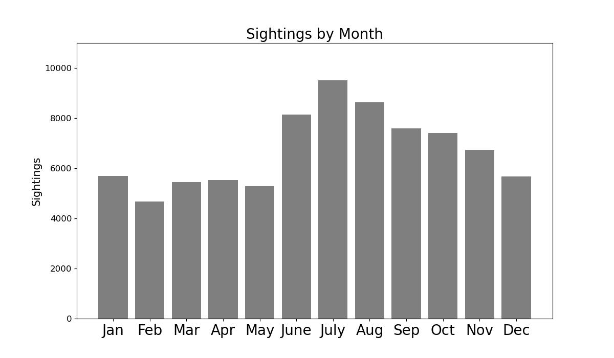
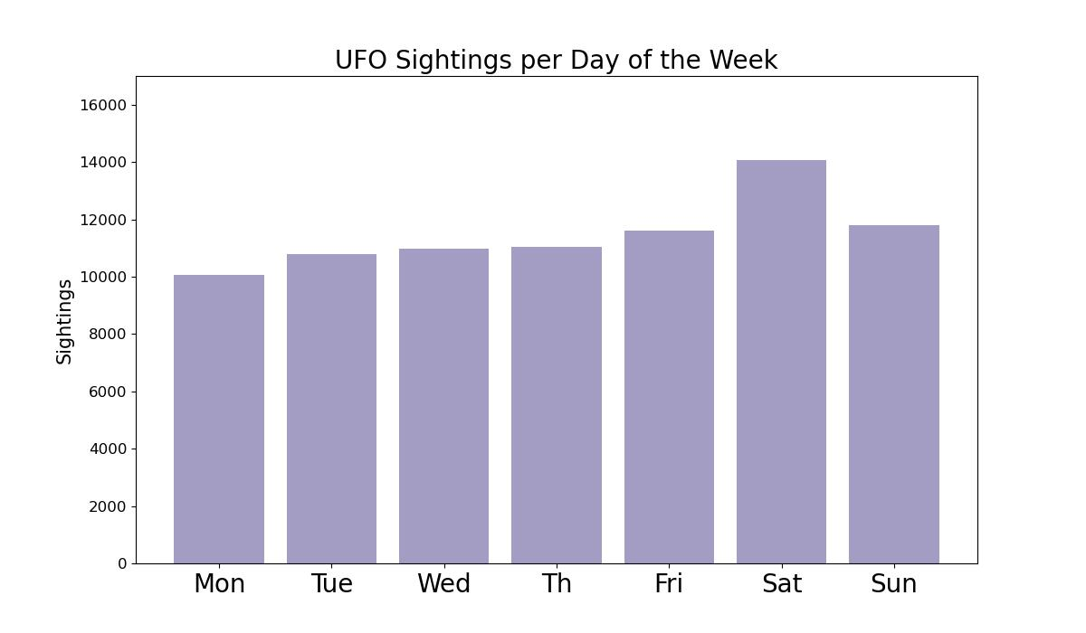
Date and Time
Photo by Marko Klaric: https://www.pexels.com/photo/clipboard-with-calendar-placed-on-desk-amidst-stationery-6408282/
Using data from NUFORC.org

Slide 9
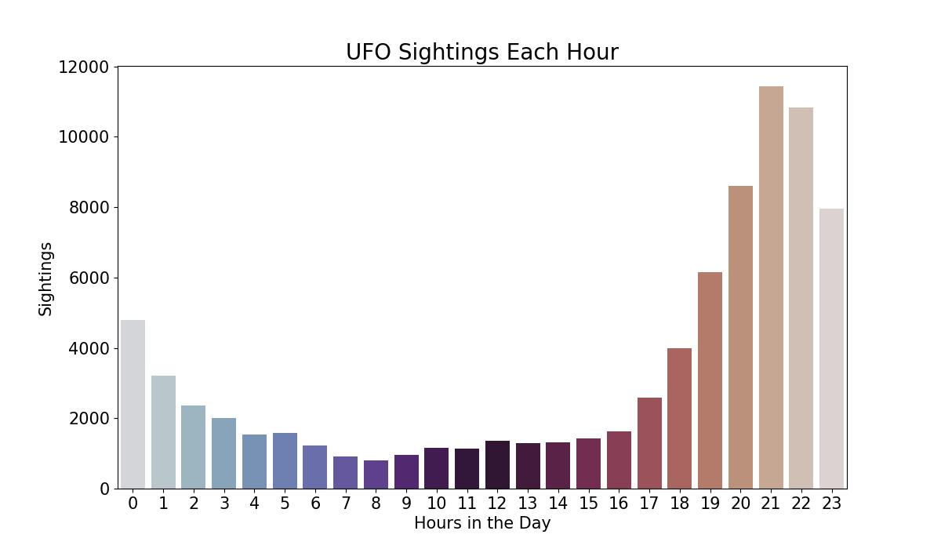
Using data from NUFORC.org

Slide 10

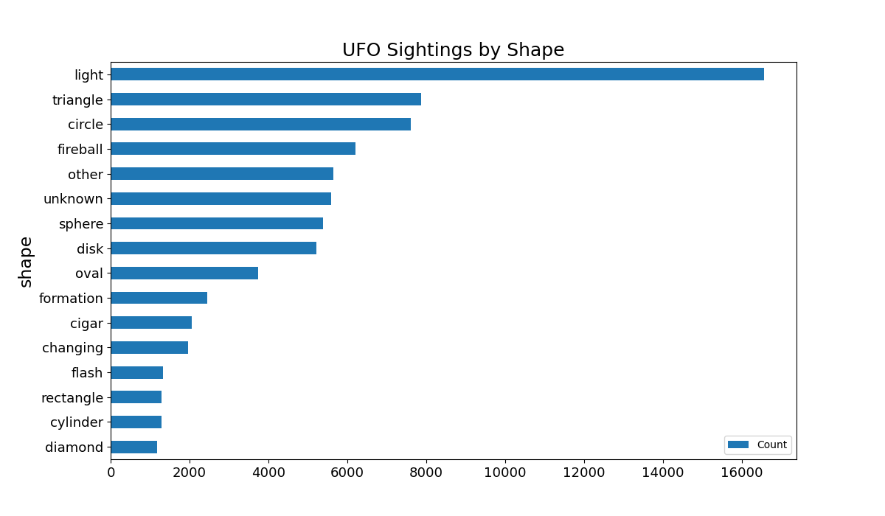
UFOs - Shapes and Colors
Photo by Thijs van der Weide: https://www.pexels.com/photo/light-bokeh-photography-792972/
Using data from NUFORC.org
Notes:
After grouping the data by shapes, I created a horizontal bar chart to see the frequency of each shape. The data includes other and unknown shapes too.

Slide 11
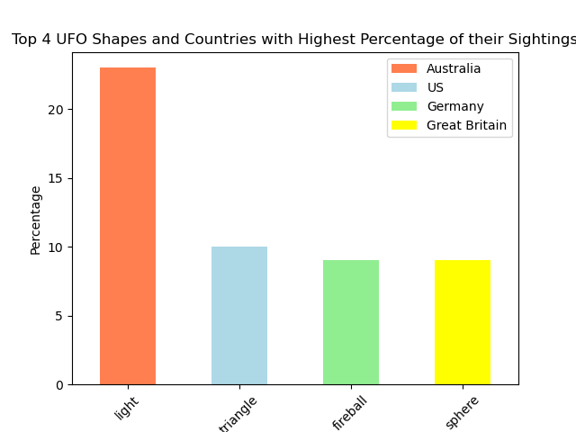
UFOs - Shapes and Colors
Photo by Thijs van der Weide: https://www.pexels.com/photo/light-bokeh-photography-792972/
Using data from NUFORC.org

Slide 12
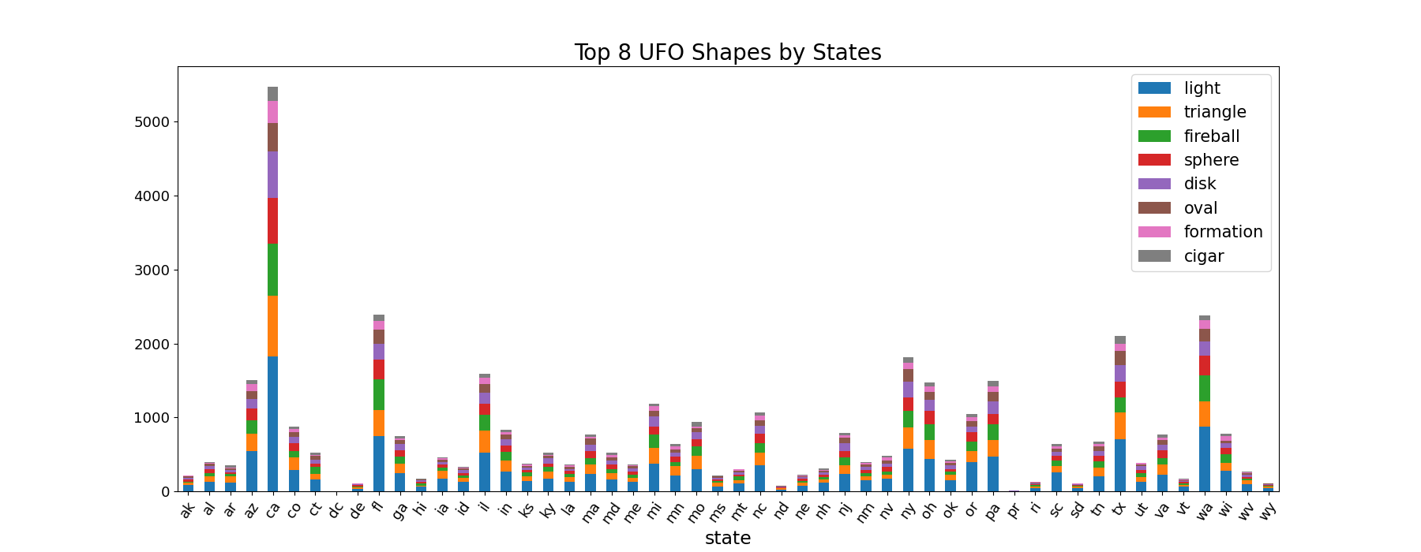
UFOs - Shapes and Colors
Photo by Thijs van der Weide: https://www.pexels.com/photo/light-bokeh-photography-792972/
Using data from NUFORC.org

Slide 13
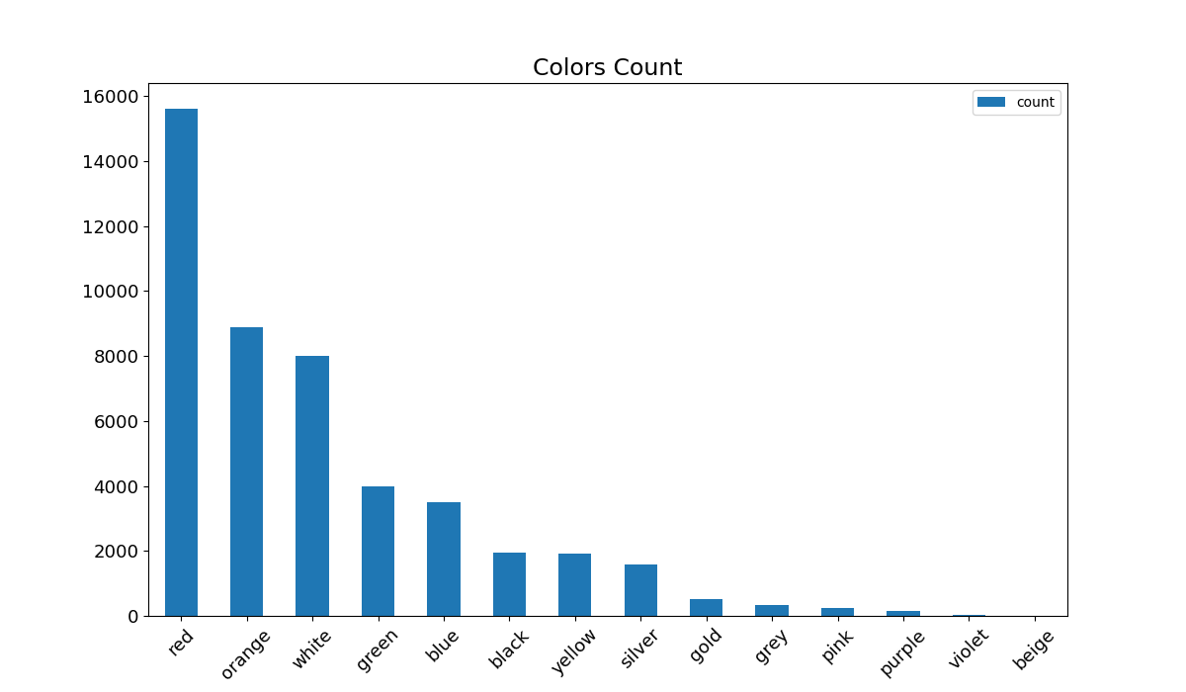
UFOs - Shapes and Colors
Photo by Thijs van der Weide: https://www.pexels.com/photo/light-bokeh-photography-792972/
Using data from NUFORC.org

Slide 14
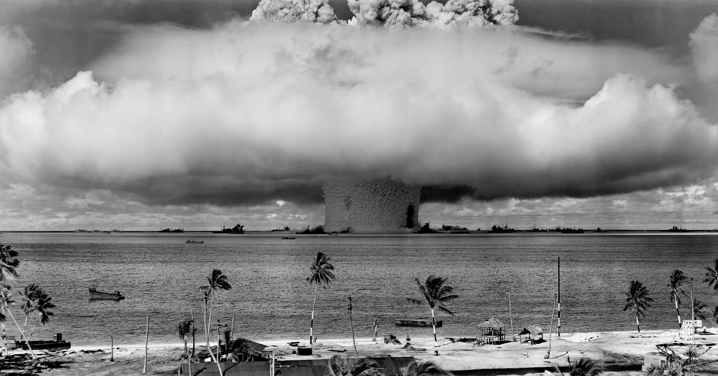
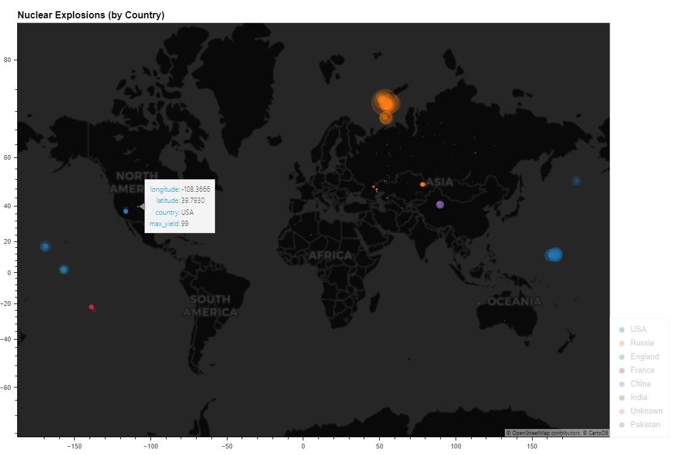
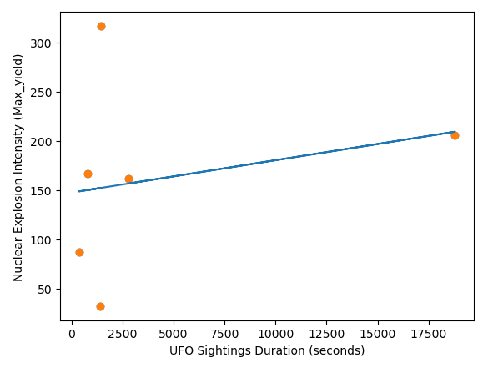
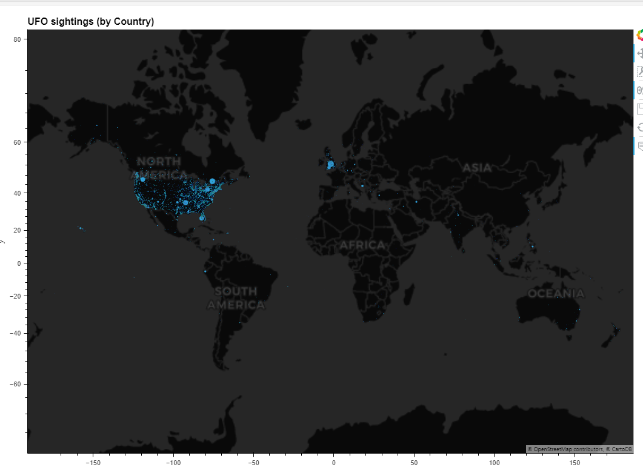
Nuclear Activity
“Out of 80K+ UFO records available, a mere 900 records have an overlap with a documented Nuclear event.
Yet these 900+ rows show a correlation of 0.24!
What are the odds!!!
Using data from NUFORC.org
Photo by Pixabay: https://www.pexels.com/photo/grayscale-photo-of-explosion-on-the-beach-73909/
Using data from NUFORC.org

Slide 15
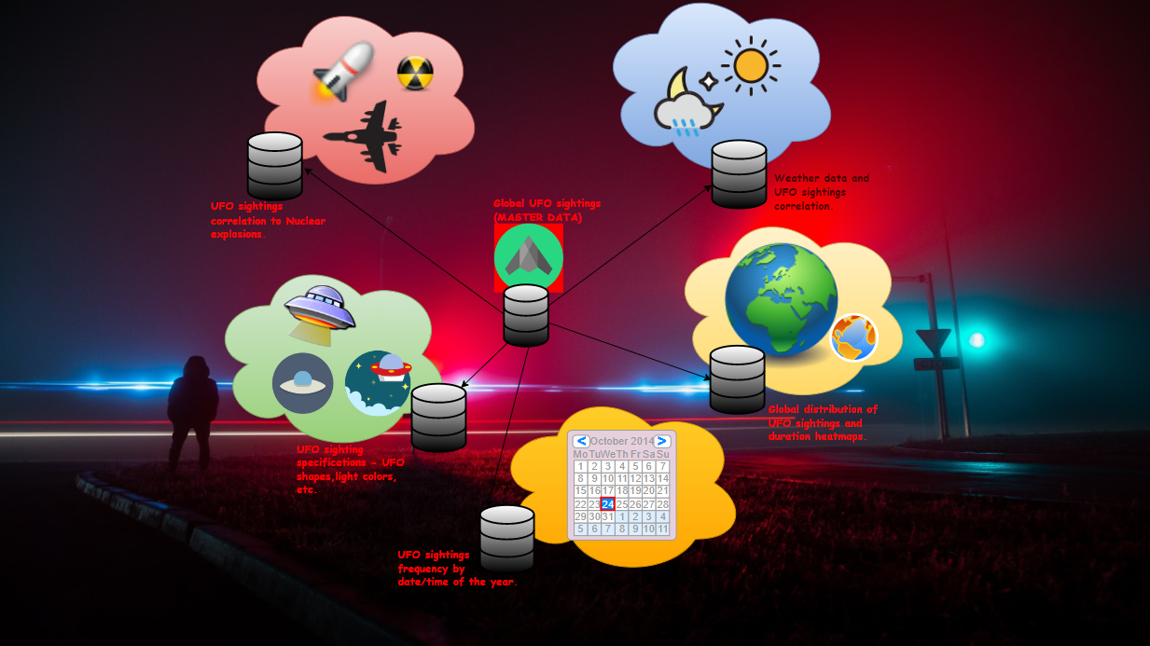
Data Strategy
Using data from NUFORC.org

Slide 16
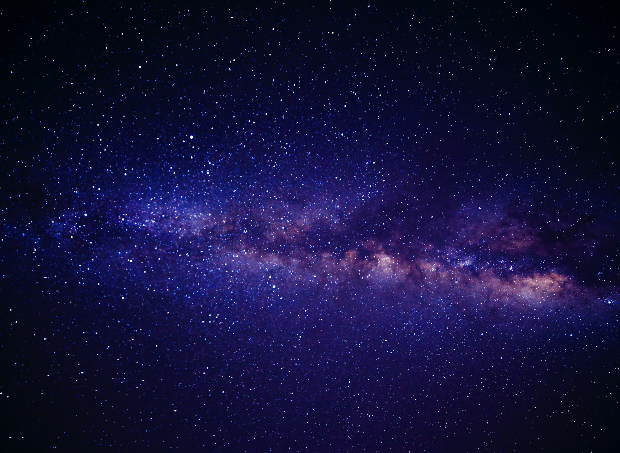
Summary
Considering the minimal overlap between Nuclear data and UFO data, even a low correlation value (0.24) proves to be statistically significant!!
So the most likely geographical locations for an alien ship sighting could happen possibly around areas with the highest nuclear activities.
The USA is the country most commonly visited by unexplained apparitions, with California leading the way for state sightings by a margin of 250%
Photo by Miriam Espacio: https://www.pexels.com/photo/blue-pink-and-white-andromeda-galaxy-way-110854/

Slide 17
Summary
The most frequently sighted UFO is not a shape but light.
The top 4 shapes (light, triangle, fireball, sphere) are more likely to be sighted in these countries in the following order: Australia , US, Germany, and Great Britain.
The frequency distribution of the shapes is consistent across the states and follows the same pattern for each state.
The most frequently sighted color of an UFO is red followed by orange and white.
Photo by Miriam Espacio: https://www.pexels.com/photo/blue-pink-and-white-andromeda-galaxy-way-110854/

Slide 18
Thank you!
Questions?
Photo by Miriam Espacio: https://www.pexels.com/photo/blue-pink-and-white-andromeda-galaxy-way-110854/

